Slide 1
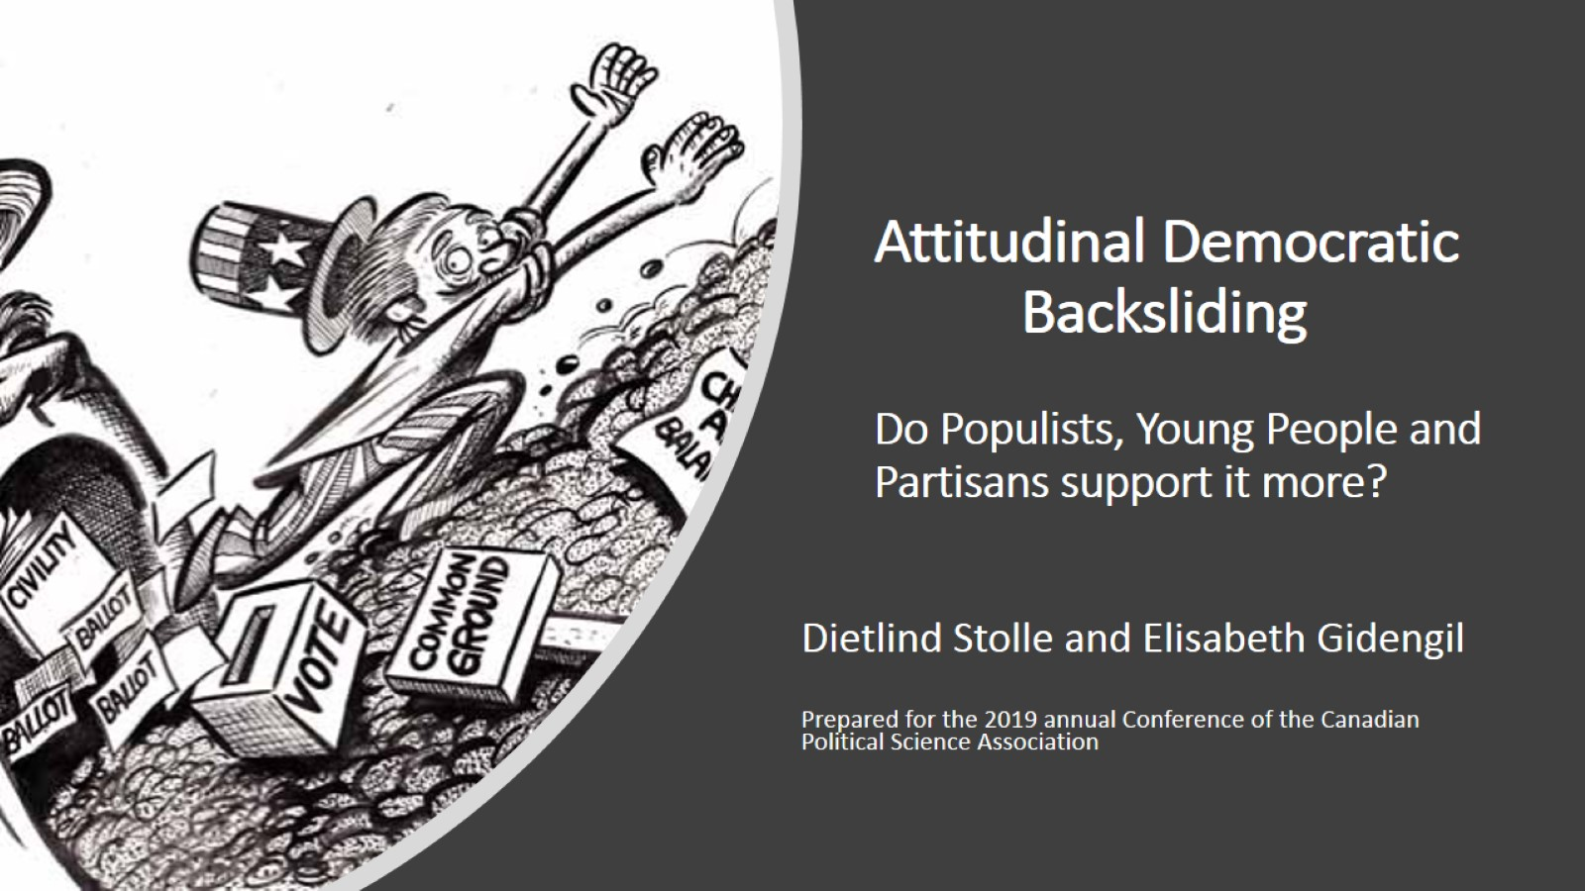



Attitudinal Democratic Backsliding Do Populists, Young People and Partisans support it more?
Are younger age cohorts less democratic?
Olivier Bergeron-Boutin, Dietlind Stolle and Elisabeth Gidengil
Prepared for the CSDC Conference Diversity and the State of Democratic Citizenship, April 2021
Notes:
Collaborative project with Olivier and Elisabeth. Here we like to contribute to solving the puzzle about the questions whether younger cohorts have a problem with democracy or not.

Slide 2
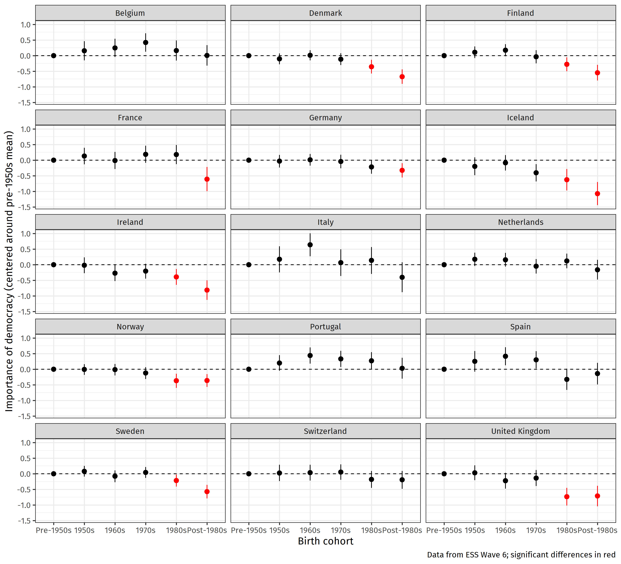
There is evidence that younger cohorts are less supportive of democracy (see also Foa and Mounk 2016, 2017). OUR QUESTIONS: How can we explain this result? What can we find out about how younger cohorts view democracy? Graph shows ESS data
Notes:
So, we start from the premise that some authors have found—as we do here--that younger cohorts (born in the 1980s or 1990’s, just around 2000) do not think that democracy is important. The graph shows ESS data in the most advanced democracies and 9 out of 15 countries do show a cohort effect, that is younger cohorts are significantly less supportive of democracy compared to the oldest cohort. Confirms some claims by Foa and Mounck and others. But also a lot of pushback on this claim--That young cohorts are even more democratic, that there is measurement error or that authors exaggerated their claim. In this project we try to understand what’s behind young people giving less importance to democracy? Are they really against it and for authoritarian solutions (antipathy to democracy) or simply not aware or confused (apathy). Or simply more critical citizens?

Slide 3
Hypotheses
Younger cohorts….
…are more critical citizens
…are confused about alternatives to democracy
…might react differently to scenarios about democratic backsliding of politicians than more abstract democracy questions
….have less knowledge
Notes:
Here are our hypotheses that we explore for this presentation, to give you a taste.
We explore whether younger cohorts are more critical citizens—who criticize democracy and how it is enacted today, but still keep it in high esteem.
Second, we explore whether younger cohorts are simply confused about what democracy means and how to distinguish democracy from its alternatives.
We explore whether it is maybe the word democracy or the abstractness of the concept which explains lower support, and we developed concrete scenarios and experiments that test the reactions to very undemocratic situations.
Finally we explore whether younger cohorts simply have lower democratic knowledge.

Slide 4
Data
ESS Wave 6 (2012) with 28,117 respondents (advanced democracies)
Democratic Backsliding Surveys →2018 in US (N=2,400)
→2019 in US and Canada (N=1,800 for both)
COVID and Democracy Survey 2020 in English-speaking Canada (N=2,421) and US (N=2,727)
Notes:
Here is the data we use. Hand over to Olivier.

Slide 5
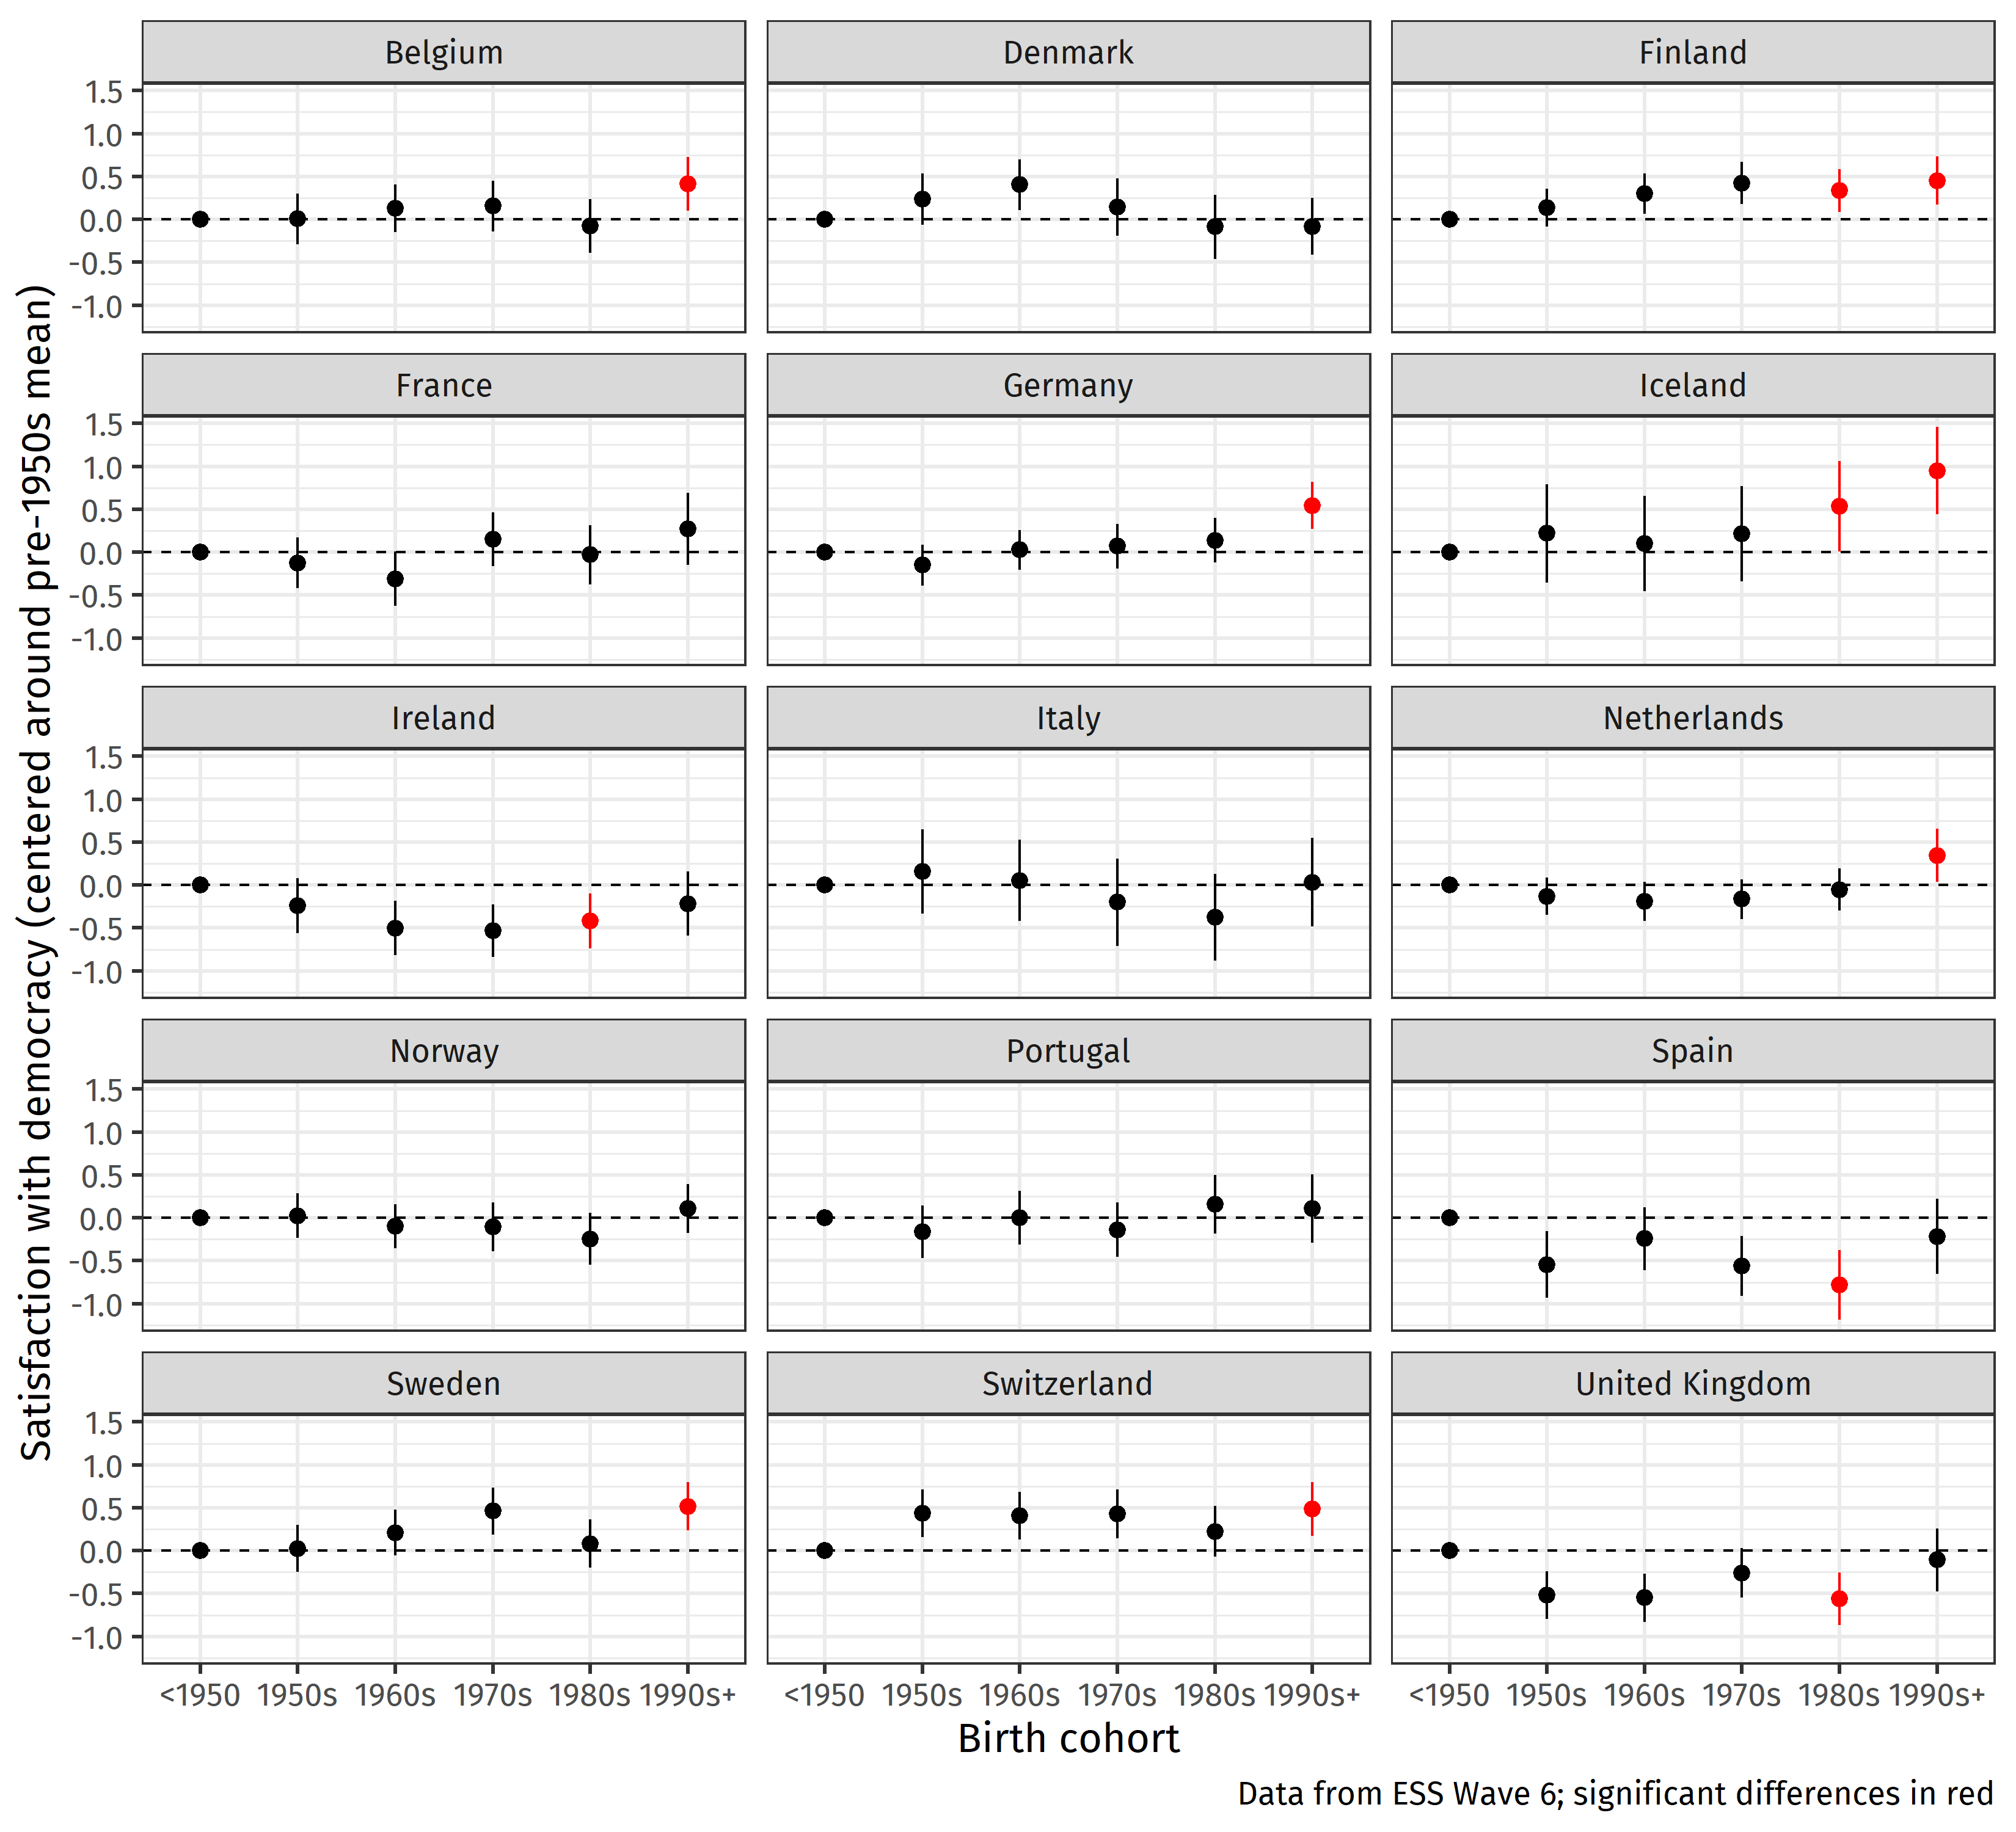
Critical Citizens? There is no evidence that younger cohorts are more dissatisfied with democracy. But their dissatisfaction translates into less support for democracy compared with older cohorts.
Notes:
1) Critical citizens: first of all—younger cohorts are not more critical of democracy than older cohorts, as they do not indicate more dissatisfaction. However, in a Model using the ESS: (Importance) = Satisfaction + Cohort + Cohort:Satisfaction + Country we examined whether the effect of dissatisfaction on importance of democracy changes by cohort. We found is that dissatisfaction with democracy has a more negative effect on support for democracy among younger cohorts (compared to older cohorts=grey line).
This suggests that their disappointing experience with democracy→ translates into a perception that “democracy as a principle” is not really important. There is no distinction between the abstract concept and reality they experience. Maybe harder when people do not have positive experiences in their memory. Anyway, no evidence of critical citizens. Critical citizens would criticize democracy more than others, but would still value it in principle. BUT ISN’T THIS OBVIOUS FROM OUR FIRST GRAPH?

Slide 6
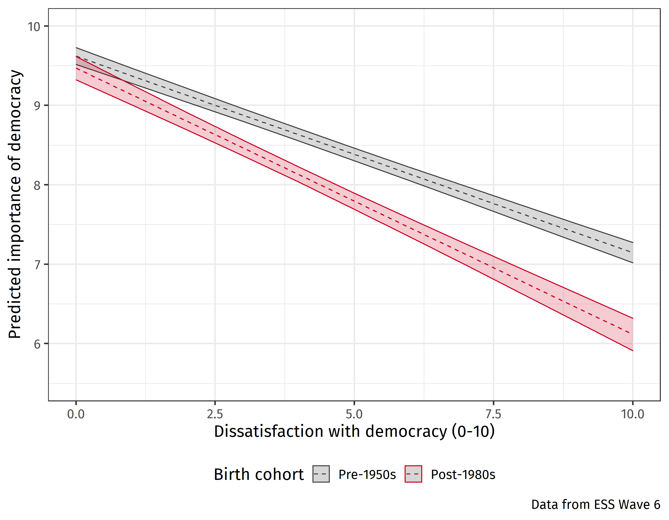
Critical Citizens? There is no evidence that younger cohorts are more dissatisfied with democracy. But their dissatisfaction translates into less support for democracy compared with older cohorts.
Notes:
1) Critical citizens: first of all—younger cohorts are not more critical of democracy than older cohorts, as they do not indicate more dissatisfaction. However, in a Model using the ESS: (Importance) = Satisfaction + Cohort + Cohort:Satisfaction + Country we examined whether the effect of dissatisfaction on importance of democracy changes by cohort. We found is that dissatisfaction with democracy has a more negative effect on support for democracy among younger cohorts (compared to older cohorts=grey line).
This suggests that their disappointing experience with democracy→ translates into a perception that “democracy as a principle” is not really important. There is no distinction between the abstract concept and reality they experience. Maybe harder when people do not have positive experiences in their memory. Anyway, no evidence of critical citizens. Critical citizens would criticize democracy more than others, but would still value it in principle. BUT ISN’T THIS OBVIOUS FROM OUR FIRST GRAPH?

Slide 7
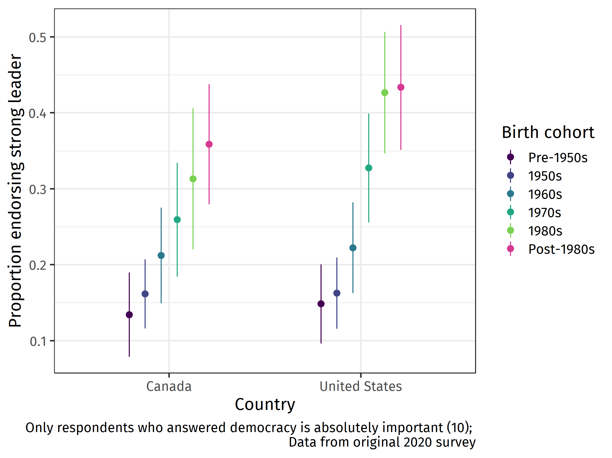
Confused Citizens?
Showing proportion endorsing a strong leader for respondents who score 10 on importance for democracy
Notes:
So, we move to our next hypothesis about confused citizens. Maybe we can also call this: confused measures. We show here an interesting phenomenon, namely many of those who value democracy the most (rate it 10) nonetheless approve of a strong leader who does not have to bother with parliament or Congress.
The graph here from Canadian and US data suggests that the standard measure of democratic support is not being understood well or even correctly, especially by younger cohorts. Even though these younger cohorts rate the importance of democracy highest they still think that a strong leader who does not have to bother with parliament/Congress is a good form of government (about 35% in Canada and 45% in US). That percentage is even higher for folks who do not value democracy as highly (understandably so). It seems not only do young people give lower marks to democracy, those who give high marks do not understand fully what it means. So, it is thus also unclear whether we can even trust these measures of broad democratic support. We need to look beyond plain democratic support to understand how young people really think about democracy.

Slide 8
Alternative Measures of Democratic Support
Concrete Backsliding Scenarios with which respondents agree or disagree
Wording experiments
Vignette Experiments
Conjoint Experiments
→ the point is to ask about democracy not in an abstract sense but by providing more concrete situations that are clearly undemocratic
Notes:
For that purpose, we developed measures of situations that are clearly undemocratic and we measure peoples acceptance of such situations.
We developed Scenarios depicting executive aggrandizement or (as currently very important) limitations on voting rights.
We created a Vignette experiment to ask about a political decision that is clearly undemocratic.
And we conducted Conjoint experiments
We have lots of evidence beyond asking about abstract support for democracy, more than we can show. But we can give you a taste.

Slide 9
Scenarios: Some Examples of Measures of Support for Democratic Backsliding in US (2018)
Support for Executive Aggrandizement (Examples) alpha=.80
When Congress is obstructing a president’s agenda, the president should shut down Congress and govern on his/her own.
Presidents should be able to veto bills even if two-thirds of members of Congress have voted to pass them into law.
Presidents should have the power to appoint Supreme Court judges without getting approval from Senate.
Notes:
Start with the scenario approach. Important because we ask about politicians behavior in concrete situations. Here you see some examples of executive aggrandizement. We ask whether people accept these scenarios or not.

Slide 10
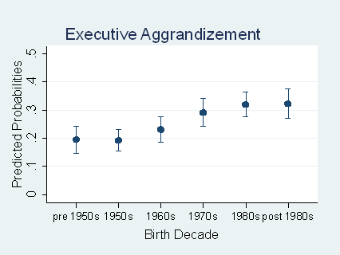
Young cohorts support executive aggrandizement more than other cohorts, USA 2018
The model controls for education, economic deprivation, sex, party ID and
strength, race, being a born-again Christian, unemployed and region of
residence.
Notes:
When using these statements on executive aggrandizement on a scale, we see relatively strong effects for cohort, with younger cohorts being clearly more open to executive aggrandizement. US data.

Slide 11
Scenarios: Some Examples of Measures of Support for Democratic Backsliding in US (2018)
Support for Limiting Voting Rights (Examples) alpha=.6
It should be made harder for some citizens to vote in elections in our country.
Only native-born Americans should have the right to vote in presidential elections.
Notes:
Here are examples of voting rights scenarios that we are using, they are clearly undemocratic. Statements about voting rights.

Slide 12
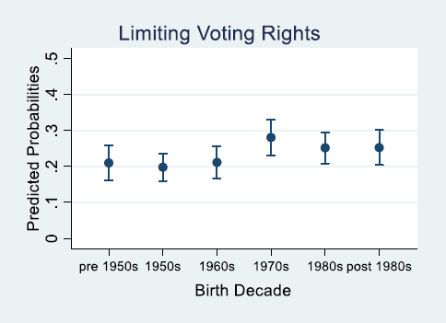
Young cohorts support limiting voting rights more than other cohorts, USA 2018
The model controls for education, economic deprivation, sex, party ID and strength, race, being a born-again Christian, unemployed and region of residence.
Notes:
The same tendency can be found for limitations on voting rights, although the cohort differences here are smaller.

Slide 13

Vignettes
A [Democratic] [Republican] [empty ﬁeld] governor wants to open businesses again to stimulate the economy. The infection rate in the state is relatively high. The state legislature is arguing against this step and wants to continue the lockdown for two more weeks. Should the governor shut down the legislature and open businesses?
A [Democratic] [Republican] [empty ﬁeld] governor wants to continue the lockdown. The infection rate in the state is slowing down. The state legislature is arguing against this step and wants to open businesses immediately to stimulate the economy. Should the governor shut down the legislature and continue the lockdown?
Notes:
In our 2020 surveys we introduced a vignette experiment describing a governor who either wants to open businesses again to stimulate the economy (Although infection rate is high) or a governor who wants to continue the lockdown (although the infection rate is slowing). In both scenarios we have a state legislature contradicting the governor. The question is whether the governor should shut the legislature (basically shut them down to press through his/her policy. Clear example of executive aggrandizement (shutting out checks of exec power). 6 scenarios. In our vignette. (but do not focus on the partisan issue).

Slide 14
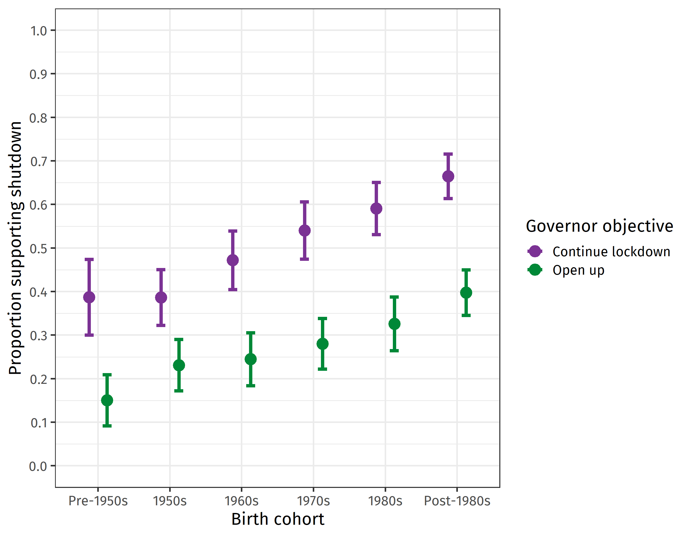
Younger cohorts are more inclined to allow the governor to shut down the legislature, especially when the governor wants to continue the lockdown.
Notes:
In our vignette as well, younger people are more inclined to allow the governor to shut down the legislature, especially when the governor wants to continue the lockdown (about 40% of oldest generation versus nearly 70% of the youngest one). The question here is very different from the research about supporting an abstract concept such as democracy which has found similar tendencies. So our scenarios make very clear that younger cohorts are not as committed to democracy as older generations.

Slide 15



Even concrete scenarios show that younger cohorts are not fully supportive of democracy. So why is that?
Critical Citizens
Confused Citizens
Democracy versus actual Backsliding
Democratic Knowledge
Notes:
So for now we have looked into the critical citizen argument and found nothing. Instead we found that dissatisfaction with democracy translates more into lack of support for it especially for younger cohorts. We also found that younger cohorts are generally more in support of a strong leader who does not have to bother with elections and parliament, and even those who support democracy to the highest degree. Younger cohorts seem to be more confused about the alternatives to democracy. We have also tested how younger cohorts react to actual undemocratic situations and found again and again that younger cohorts are more accepting of situations of dem backsliding than older cohorts. Lower ratings also indicate that actual undemocratic scenarios are supported. We can dig deeper here and see whether democratic knowledge has anything to do with it.

Slide 16
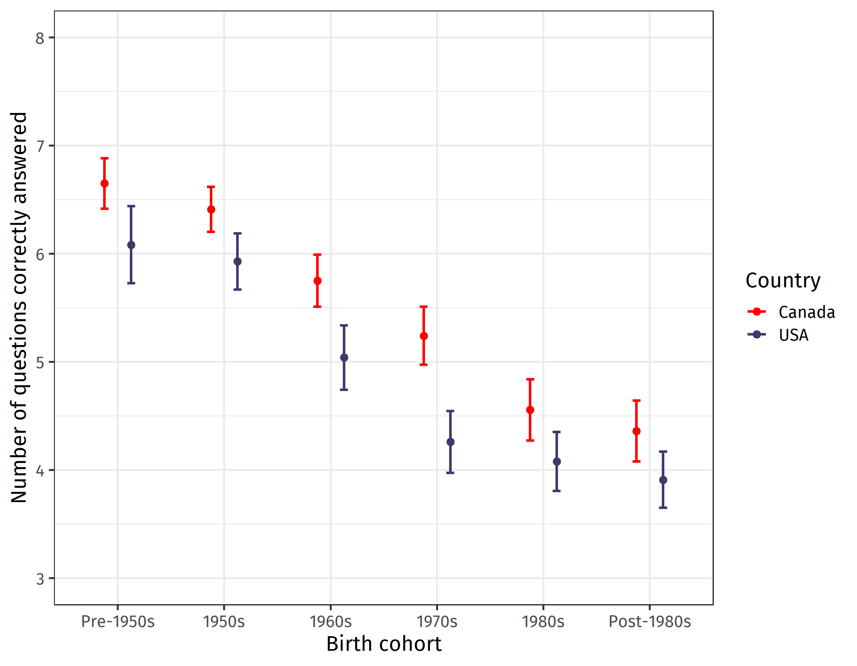
Democratic Knowledge
Data from 2019
Notes:
When asked about recognizing whether a situation is democratic or undemocratic, we show respondents various scenarios and ask them to evaluate them in degrees of being democratic or undemocratic. An example is: A prime minister or president attacks the legitimacy of an election in which they have been defeated. OR: A government blocks peaceful protests by its political opponents. When adding up the correct answers to a democratic knowledge scale, we see strong cohort differences. In fact the youngest cohort in the US is in the least likely to know whether a situation is democratic or not. In our research we show that this knowledge is key in rejecting or condoning democratic backsliding. Canadian young cohorts follow suit.
Note that this is from the 2019 survey.

Slide 17
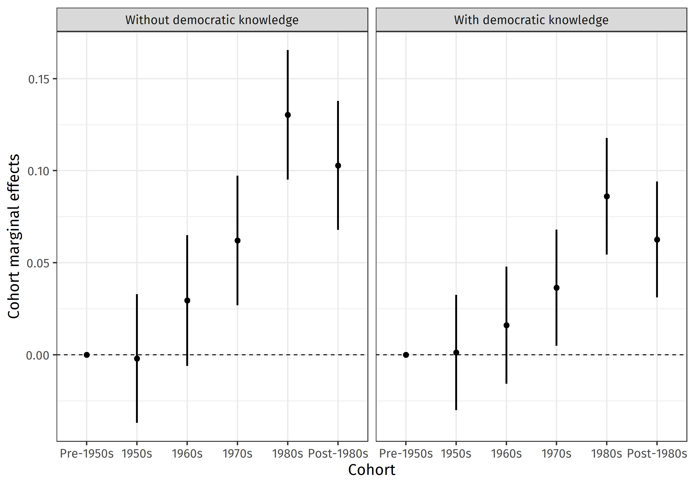
Democratic Knowledge diminishes the cohort effect, but does not eradicate it
Example: Executive Aggrandizement in the US
USA 2020
Notes:
When we use a similar scale and test whether cohort effects diminish after including democratic knowledge, we do see diminished effects, but they are not completely eradicated.

Slide 18
Overall Conclusion
Younger cohorts seem to be less inclined to believe in the importance of democracy.
Even when they believe it’s important, they still support strong leaders who do not bother with parliaments and Congress to an astoundingly high degree
Young cohorts do not appear to be critical citizens as some have argued
Younger cohorts are more accepting of democratic backsliding scenarios
Partly this is explained by a cohort-related lack of democratic knowledge and by dissatisfaction translating more into lack of support
Notes:
So, What does this mean for the future of democracy? Our conclusions seem to be a bit bleak. We set out to prove Foa and Mounck and others wrong, but the deeper we dug the more the pattern seemed to repeat itself. Of course we are not claiming that all members of the younger cohorts are less committed to democracy. Some of them have been very critical and have been supportive of democratic innovation, used media to speak out etc., But on average, the lack of understanding about what’s democratic and what is not seems to make younger cohorts more oblivious to various aspects of democracy. Their dissatisfaction with democracy although not high than other cohorts also also more damning for their support. So far our results suggest that: Should democracy be under threat (which it is), the younger cohorts might not be standing up for it in the same way as their older counterparts. More work needs to be done.

Slide 19
Additional Slides

Slide 20
Democratic/Undemocratic Positions
Democratic Attribute 1
Says…
A [prime minister][president] should work with [Parliament][Congress] even if it is obstructing his/her proposals to combat terrorism. [baseline]
A [prime minister][president] should shut down [Parliament][Congress] if it is obstructing his/her proposals to combat terrorist threats.
Democratic Attribute 2
Says…
A [prime minister][president] should always adhere to court decisions even though they might seem politicized. [baseline]
A [prime minister][president] should not be bound by court decisions he or she regards as politicized.

Slide 21
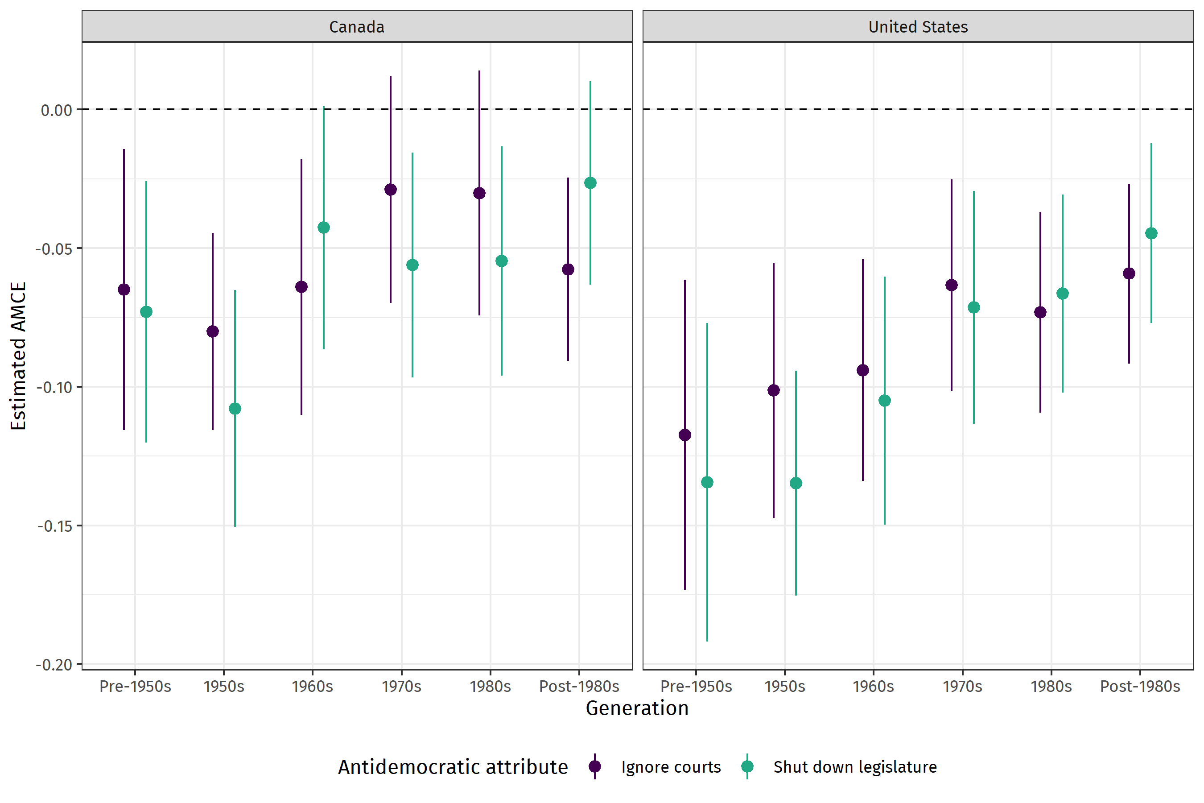
Conjoint by cohort
Notes:
We have shown the conjoint already at many conferences, so I suggest to leave it out
I changed the plot here, with countries in different panels. But I can change it back if you prefer the old ones!
AMCEs from the conjoint by generation and by country (two separate plots for the courts and legislature conditions). There's definitely a tendency toward smaller punishment as we move toward the youngest generations. (though the confidence intervals are pretty wide; but I guess since both countries and both conditions show roughly the same pattern, we can have confidence that it's real)

Slide 22
 | Limiting Voting Rights |  | Executive Aggrandizement |  | Curtailing Democratic Freedoms
 | coeff | se | coeff | se | coeff | se
Strong Democrats | -0.05** | (0.02) | -0.03 | (0.02) | -0.05*** | (0.02)
Democrats | -0.06** | (0.03) | -0.01 | (0.03) | -0.02 | (0.03)
Republicans | 0.10*** | (0.04) | 0.17*** | (0.04) | 0.02 | (0.03)
Strong Republicans | 0.14*** | (0.03) | 0.19*** | (0.03) | 0.14*** | (0.03)
Study 1: Results of LPM Analysis

Slide 23
Limiting Voting Rights
Executive Aggrandizement
Curtailing Freedoms
Study 1: Role of Party Identification

Slide 24
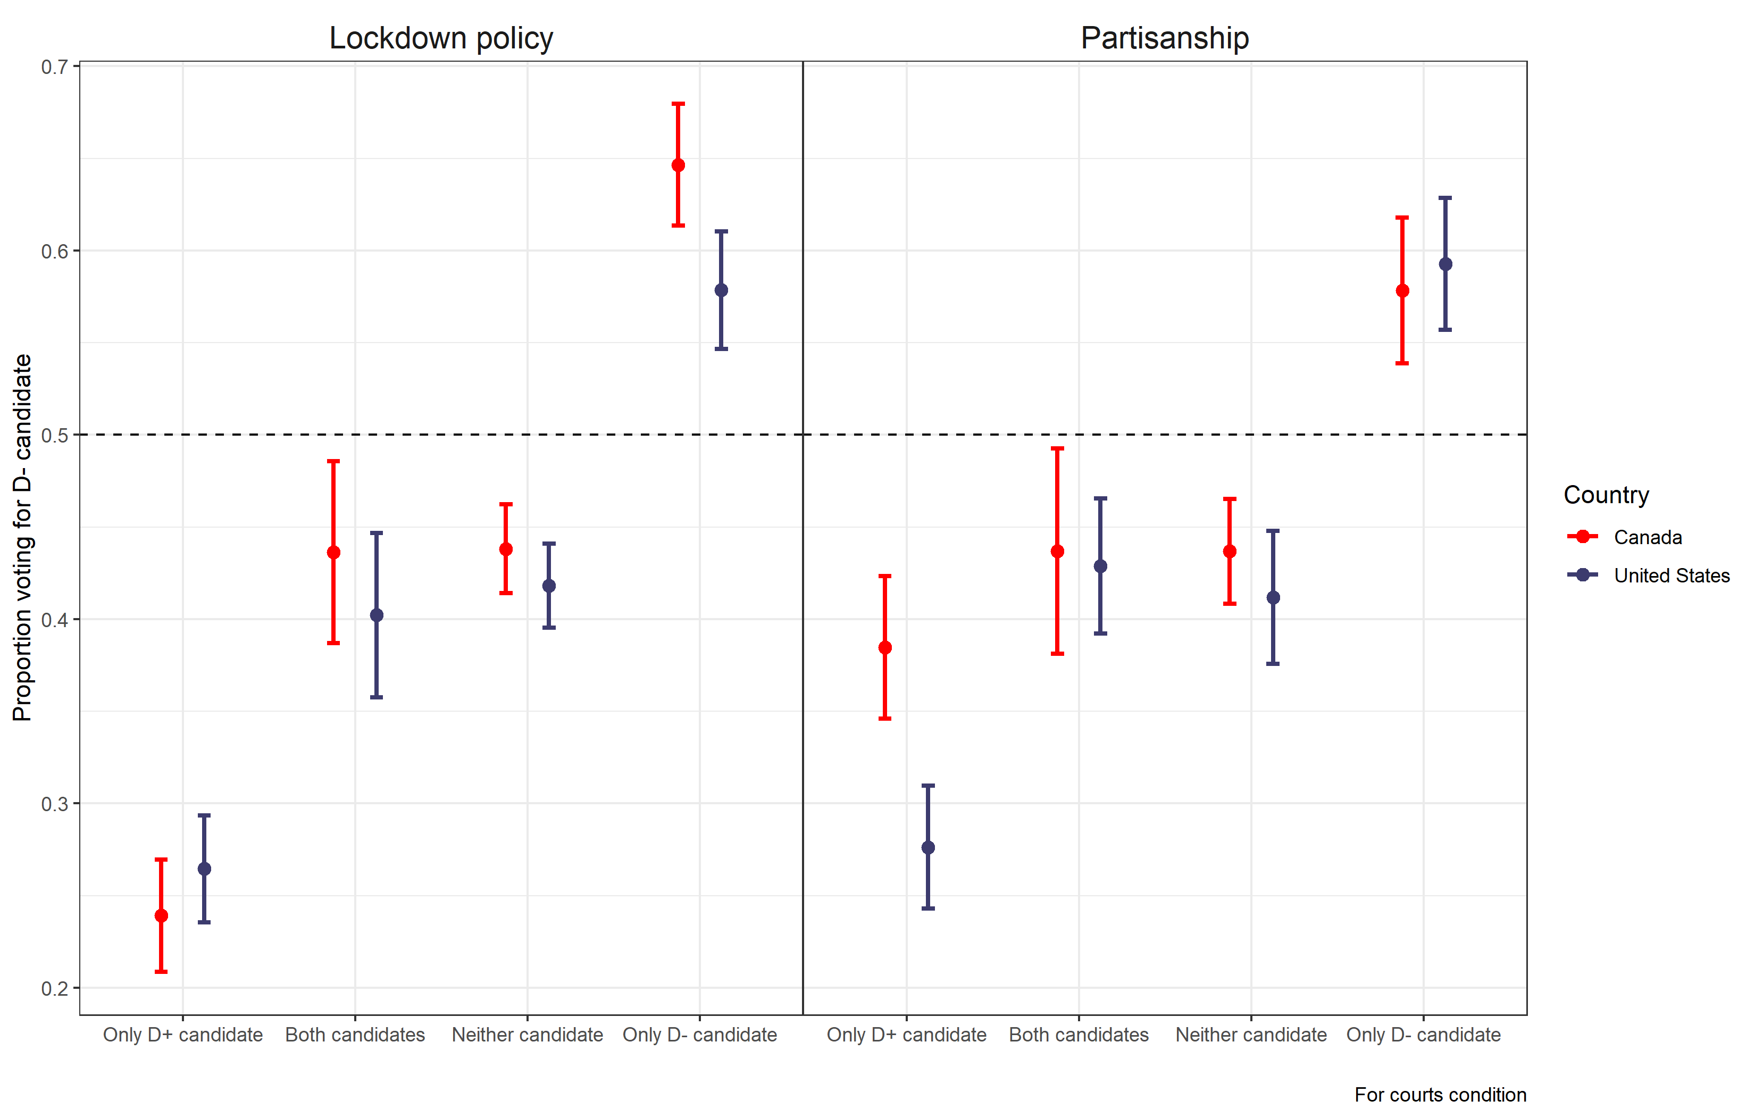
Conjoint results
Notes:
Note how lockdown policy is visibly more important in Canada vis-avis partisanship than in the US (not a good slide for the roundtable)

Slide 25
Social Sorting
Lilina Mason and Nathan Kalmoe: Radical Mass Partisanship: Prevalence and Correlates of Political Violence in American Politics
Difference Between Democrats and Republicans
More Democrats.................More Republicans
Notes:
Ideology, class, and race have overtaken Catholic, Protestant, and Union, and to a much greater extent than previous divisions.
This is related to a divide that started in 1964.

Slide 26
Moral Disengagement by Party
Mason and Kalmoe

Slide 27
Political Violence by Party
Mason and Kalmoe

Slide 28
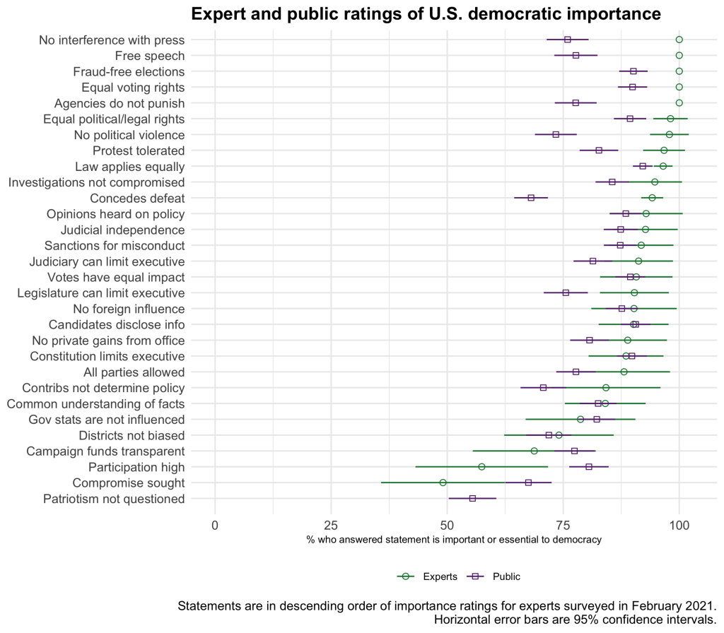
Bright Line Watch 2021
Notes:
Many more scenarios, also make you aware of the excellent work of BLW here. Maybe highlighting a few more. But our scenarios are not asking about importance but also about whether people think its ok, so goes beyond abstract recognition.

Slide 29
The governor’s party ID does not matter

Slide 30
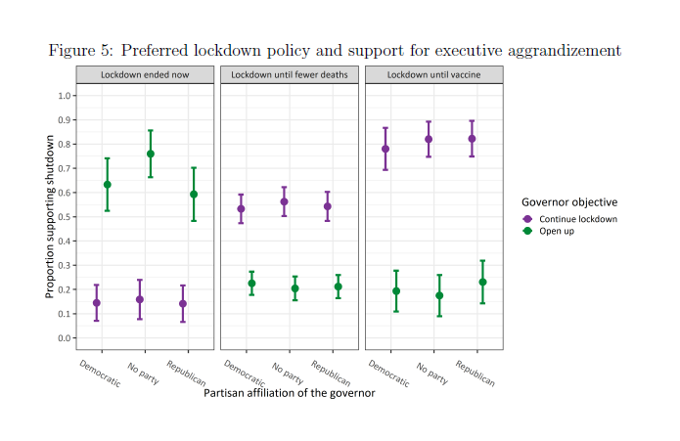
The match between lockdown policy preference and governor position matter

Slide 31
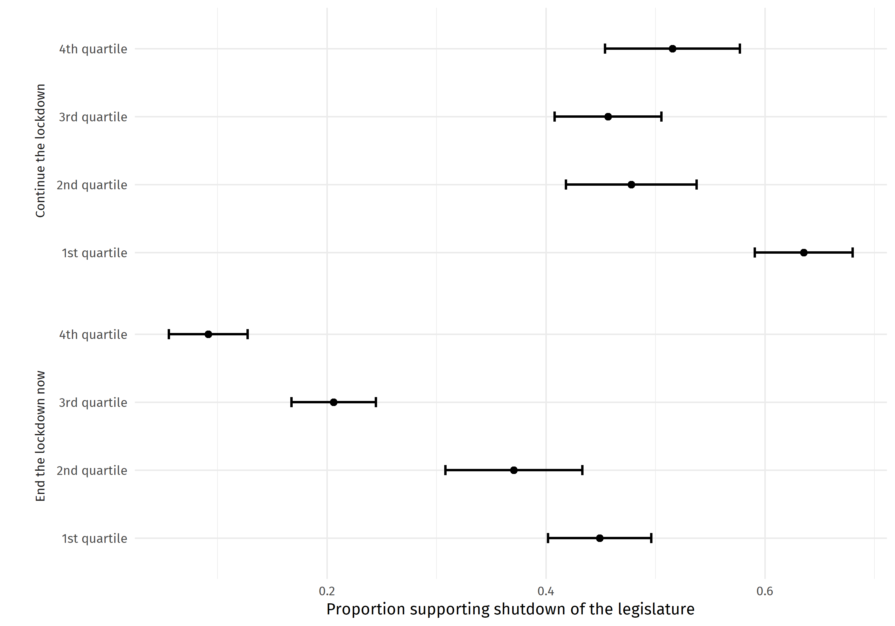
The effect of democratic knowledge on executive aggrandizement by policy stance of governor

Slide 32
COVID Anxiety increases support for executive aggrandizement to protect via COVID policy
2,700 respondents
Dynata Survey
May 2020
Notes:
Present results here by COVID anxiety levels and by Governor PID and lockdown policy stance.,First of all we see that the party affiliation of the governor does not make a difference at all. Second, we find that COVID anxiety is a strong factor that determines heavily the decision regarding the governor’s shutdown. As you can see the higher the anxiety (right panel), the higher the attention to COVID policies of the governor to the disregard of executive aggrandizement. A person with very high anxiety who received the vignette that the governor wants the lockdown and the legislature argues against it, has roughly 75% chance to decide that the governor should shut down the legislature. (we also see the effect for ending the lockdown, Q and A).

